Slide 1


How do you recognize a problem?
≠
is
want
A problem is anything that is not what
you want it to be

Slide 2
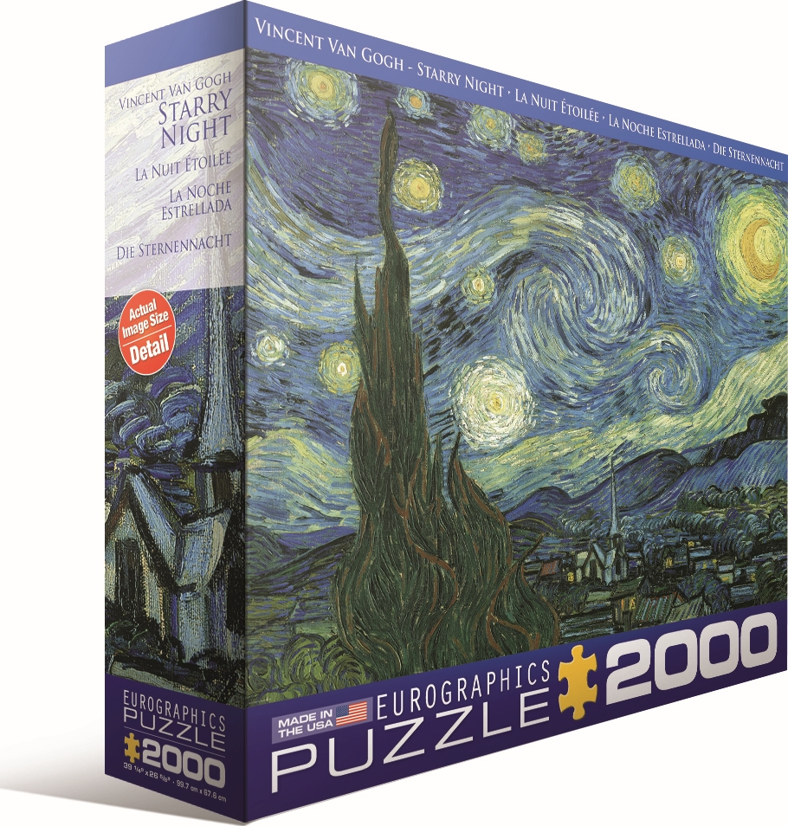
Ask yourself “What problem am I trying to solve?”
1
“What are we trying to solve?”
5

Slide 3

Do you have everything you need to begin to solve?
2
“What are the components required?”

Slide 4
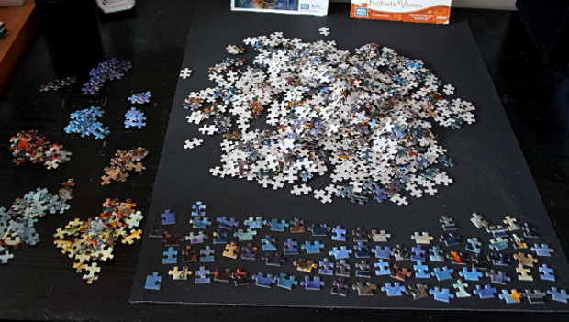
Think 5S and use it to begin to solve
3
“How do we sort the information?”

Slide 5
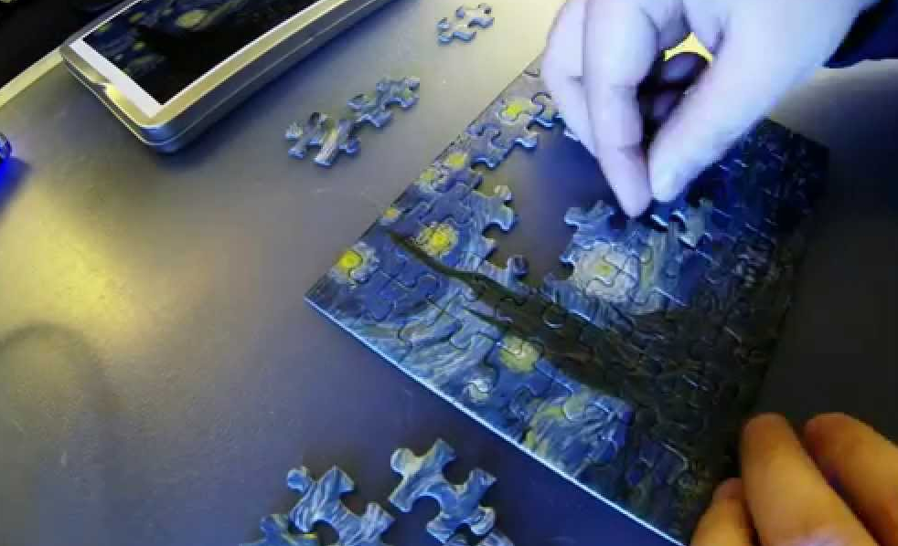
Using the appropriate method for the problem you have
4
“How do we begin to solve?”

Slide 6
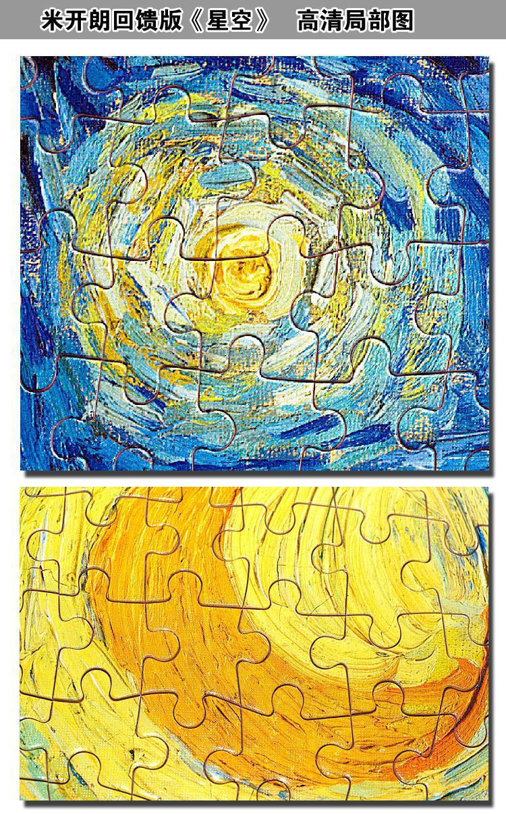
You need to be able to RECOGNIZE the solution
5
“Solved!”

Slide 7

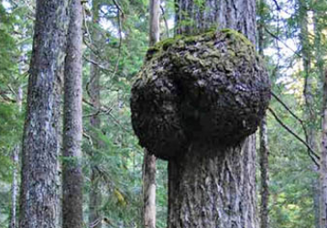

Your problem is in three distinct areas
Deviation to existing product, process, service, or information
Improvement to existing product, process, service, or information
New product, process, service, or information

